Slide 1
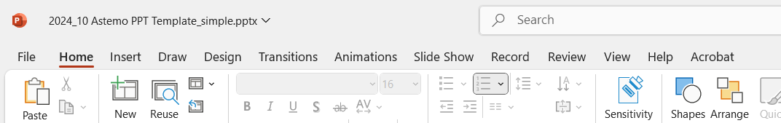
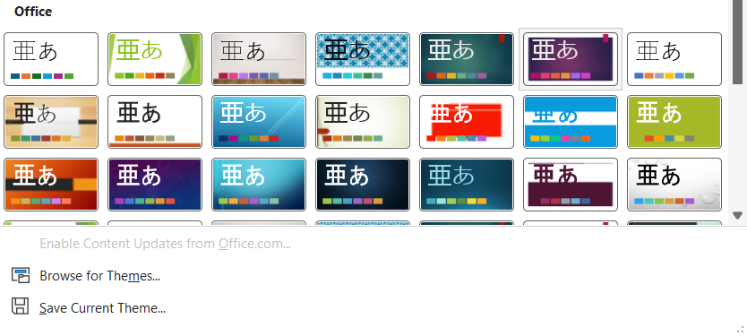
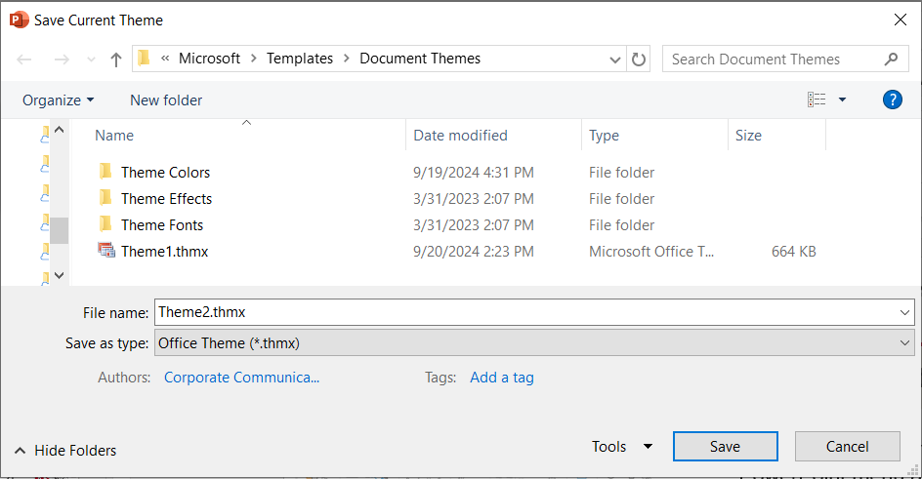
How to set Astemo template as default
Please immediately set this new theme as the default—it will save time in the long run.
With this PowerPoint presentation open and active, click the Design ribbon in the PowerPoint menu above
In the “Themes” section, click the down arrow with the horizontal line
The “Themes” section will expand. Click “Save Current Theme...” at the bottom.
When the save box dialog opens, hit save. (The file name doesn’t matter)

Slide 2
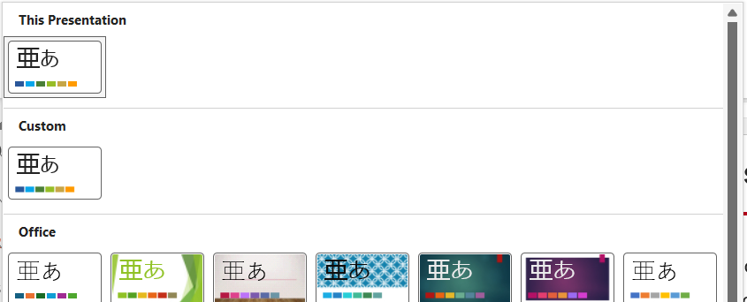
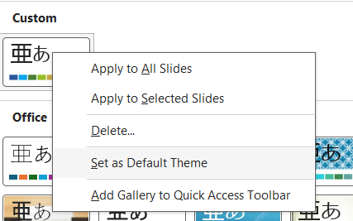
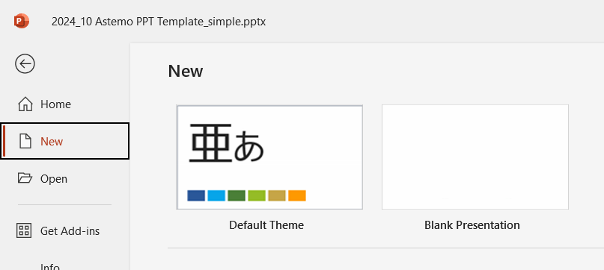
How to set Astemo template as default: Part 2
The Astemo template will now be available as a theme. From the same “Themes” section, click the down arrow with the horizontal line again.
The Astemo template theme should be visible under “Custom.” Right-click the theme.
Select “Set as Default Theme”
Astemo template will now be the default when creating a new document. It will also be selectable with any other document under Design > Themes menu
Default font: English – Arial; Japanese - Yu Gothic UI (From Oct. 2024)

Slide 3
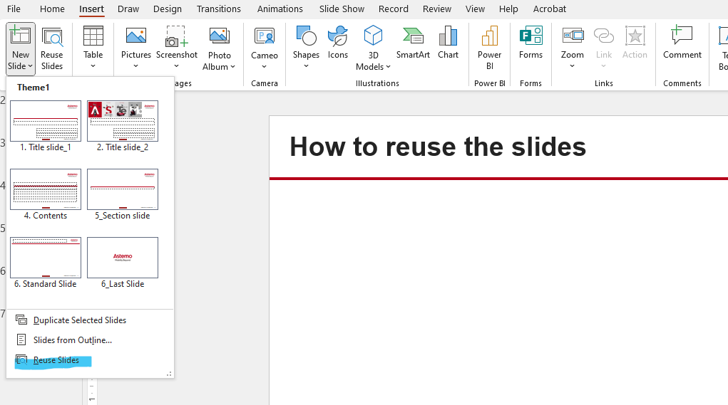
How to reuse the slides
Please also refer to Presentation style guide in the Global Gateway
Reuse (import) slides from another presentation - Microsoft Support

Slide 11
Astemo color palette
Astemo Red
C 0/100/85/30
R 182/0/26
H #B6001A
C 18/24/0/0 R 204/192/232 H #CCC0E8 | C 35/18/0/0 R 162/189/230 H #A2BDE6 | C 34/0/0/0 R 157/223/252 H #9DDFFC | C 30/1/42/0 R 182/218/169 H #B6DAA9 | C 15/0/43/0 R 220/238/167 H #DCEEA7 | C 8/9/29/0 R 234/222/186 H #EADEBA | C 0/15/41/0 R 255/217/159 H #FFD99F
C 33/42/0/0 R 170/150/217 H #AA96D9 | C 61/36/0/0 R 100/145/213 H #6491D5 | C 54/2/0/0 R 91/202/250 H #5BCAFA | C 52/2/74/0 R 133/194/112 H #85C270 | C 26/0/72/0 R 197/226/109 H #C5E26D | C 15/18/52/0 R 220/200/140 H #DCC88C | C 0/28/72/0 R 255/191/96 H #FFBF60
C 54/64/0/0 R 136/107/202 H #886BCA | C 84/62/0/0 R 50/103/183 H #3267B7 | C 65/12/0/0 R 26/181/248 H #1AB5F8 | C 70/17/100/2 R 90/157/67 H #5A9D43 | C 37/0/99/0 R 173/215/50 H #ADD732 | C 21/27/75/0 R 206/178/95 H #CEB25F | C 0/40/96/0 R 255/166/32 H #FFA620
Violet C 64/74/0/0 R 118/86/194 H #7656C2 P 814C | Blue C 92/72/9/1 R 42/87/154 H #2A579A P 7455C | Sky Blue C 71/19/0/0 R 7/166/235 H #07A6EB P 2925C | Green C 75/29/100/14 R 73/127/55 H #497F37 P 364C | Leaf green C 47/7/100/0 R 151/189/38 H #97BD26 P 376C | Gold C 24/31/87/1 R 198/166/71 H #C6A647 P 7407C | Orange C 0/46/100/0 R 255/155/0 H #FF9B00 P 137C
C 73/83/0/0 R 100/65/180 H #6441B4 | C 96/78/20/6 R 36/75/133 H #244B85 | C 79/31/3/0 R 6/144/203 H #0690CB | C 76/34/100/22 R 64/112/48 H #407030 | C 54/17/100/1 R 134/168/33 H #86A821 | C 30/36/96/4 R 181/150/56 H #B59638 | C 11/54/100/1 R 223/134/0 H #DF8600
C 90/99/13/3 R 71/46/129 H #472E81 | C 99/84/36/27 R 26/54/95 H #1A365F | C 92/56/25/5 R 4/103/145 H #046791 | C 78/38/100/32 R 55/96/41 H #376029 | C 64/34/100/18 R 96/120/24 H #607818 | C 37/43/99/12 R 152/128/48 H #9B8030 | C 22/59/100/6 R 191/115/0 H #BF7300
C 93/99/37/37 R 43/28/77 H #2B1C4D | C 94/82/48/57 R 16/32/57 H #102039 | C 98/71/44/34 R 3/62/87 H #033E57 | C 77/48/94/56 R 37/64/28 H #25401C | C 69/48/100/49 R 57/72/14 H #39480E | C 49/53/100/36 R 103/85/32 H #675520 | C 36/66/100/32 R 128/77/0 H #804D00
White
C 0/0/0/0/30
R 255/255/255
H #FFFFFF
Black
C 0/0/0/100
R 0/0/0
H #000000 FFFFF
Primary color palette
Gray 70%
C 0/0/0/0/70
R 77/77/77
H #4D4D4D
Gray 55%
C 0/0/0/0/55
R 115/115/115
H #4D4D4D
Gray 30%
C 0/0/0/0/30
R 179/179/179
H #737373
Gray 15%
C 0/0/0/0/15
R 217/217/217
H D9D9D9
Neutral color palette
Secondary color palette

Slide 12




フォントと色
フォントの色、サイズ、スタイルをうまく使うことでまとまりのある資料に
色
フォントサイズ
フォントスタイル
基本的に、フォント、図表は、
Astemoのテーマパレット色を使用
(パレットはスライド9参照)
タイトル 28 pt 太字
見出し 20 pt 太字
本文 16 pt
キャプション 12 pt
サイズを変えることでコントラストが生まれます。そのうえでバリエーションを2～3種類におさえることで、視覚的な統一性も生まれます
スペース的に小さいフォントにしたい場合は、トリミングやスライドの追加を検討
1-2 フォント (言語ごと)
英語： Arial 日本語：Yu Gothic UI
下線付き、斜体の見出しは使用しない
使用する色の系統を2～3に絞り、すっきりとした印象に
Astemo Red
White
Black
Primary palette

